Slide 1

CSET 150
Network Design and Management
Evening Masters Edition
Dr. Mahboob Qaosar
Associate Professor, CSE, RU

Slide 2
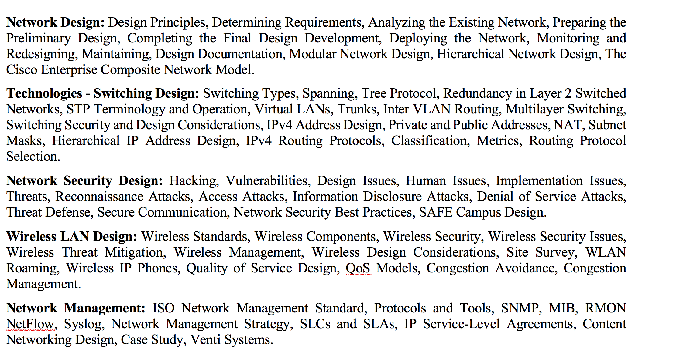
Course Contents

Slide 3
Mitigating Technologies
Mitigating Technologies
Threat Defense
Secure communication
Trust and identity
Network security best practices

Slide 4
Network security best practices
3 issues:
Network Management
Assessment and Audits
Policies

Slide 5
Network Management
There is a saying in network security: "If you log it, read it."
… firewalls, routers, and IDSs, can send syslog security triggers to a central repository such as a syslog server
Nonsense … if not use the log
… security event management software should be used
If a significant anomaly be discovered…
In addition, correlation tool modules can be added to assist the network administrator …

Slide 6
Assessment and Audits
Prior to designing your network, you should conduct a security assessment to uncover potential vulnerabilities and therefore target your security efforts where they are the most effective.
Subsequently, when your network security systems are in full production, it can be beneficial to hire a security audit company that can perform penetration testing and report on the corporate network security position.

Slide 7
Polices
Organizations must develop basic network policies, disseminate them, and enforce them:
Internet usage policy
E-mail usage policy
Remote-access policy
Password-handling policy
Software and hardware installation policy
Physical security policy
Business continuity policy

Slide 8
SAFE Campus Design
Cisco has developed a guide, called the Cisco SAFE Blueprint,
Cisco SAFE Blueprint - - - -of best practices for designing and securing networks
Cisco Enterprise Composite Network Model --- is the name given to the architecture used by the SAFE blueprint.
At the highest layer, this model divides an enterprise network into the following three main functional areas:
ENTERPRISE CAMPUS
ENTERPRISE EDGE
SERVICE PROVIDER EDGE

Slide 9
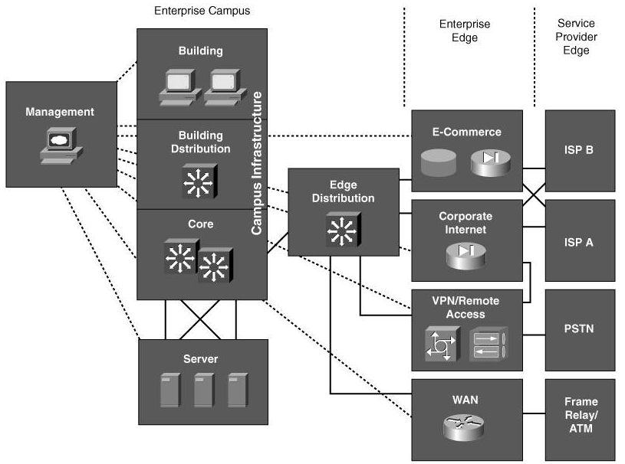
Cisco Enterprise Composite Network Model

Slide 10
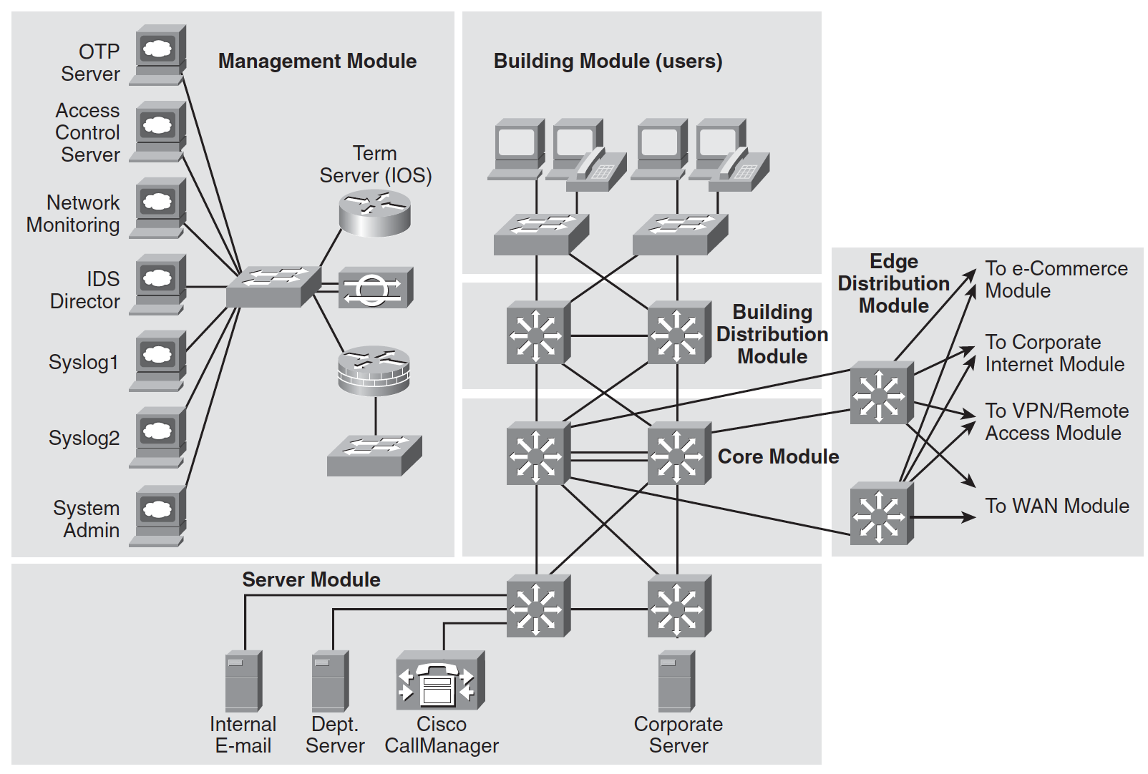

Slide 11
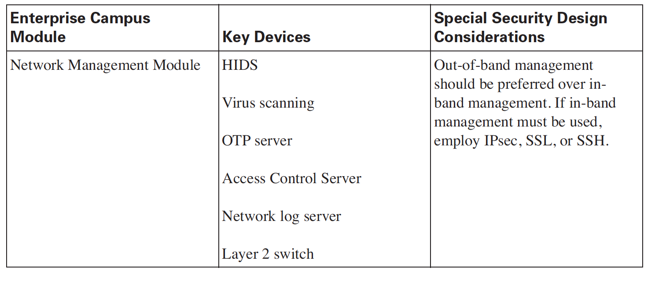
Out-of-band (OOB) management is a method of remotely controlling and managing critical IT assets and network equipment using a secure connection through a secondary interface that is physically separate from the primary network connection. This enables administrators to gain control even during infrastructure faults.

Slide 12
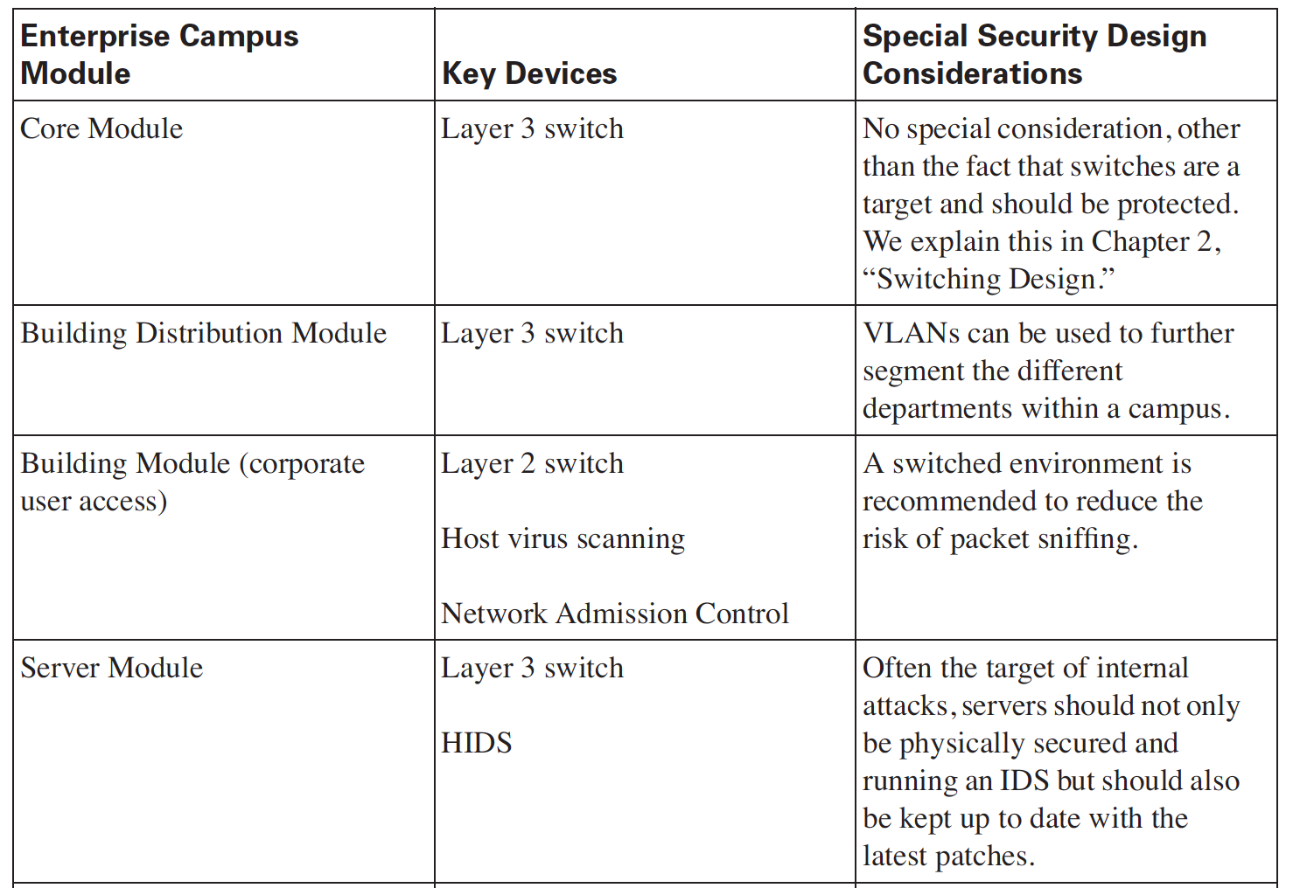

Slide 13
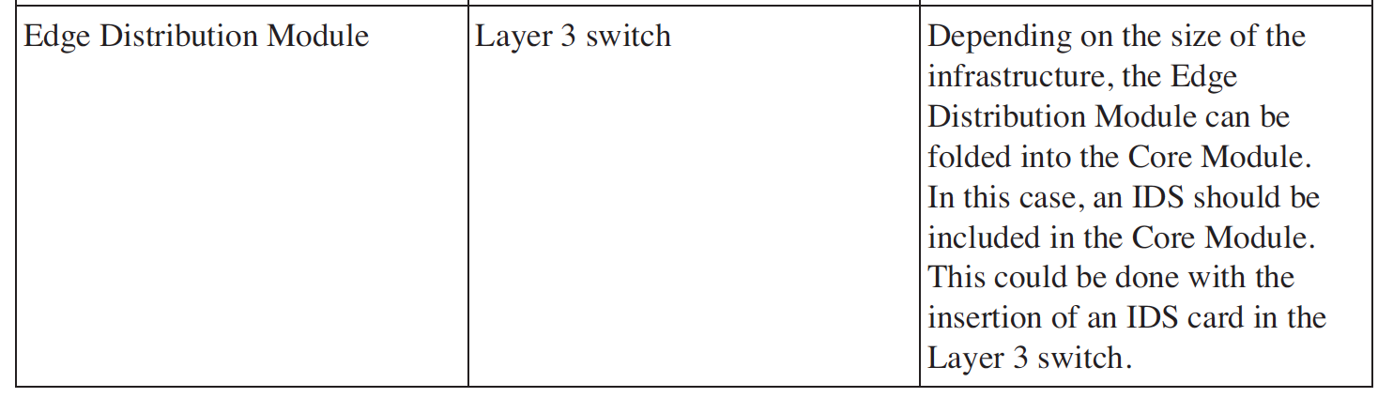

Slide 14
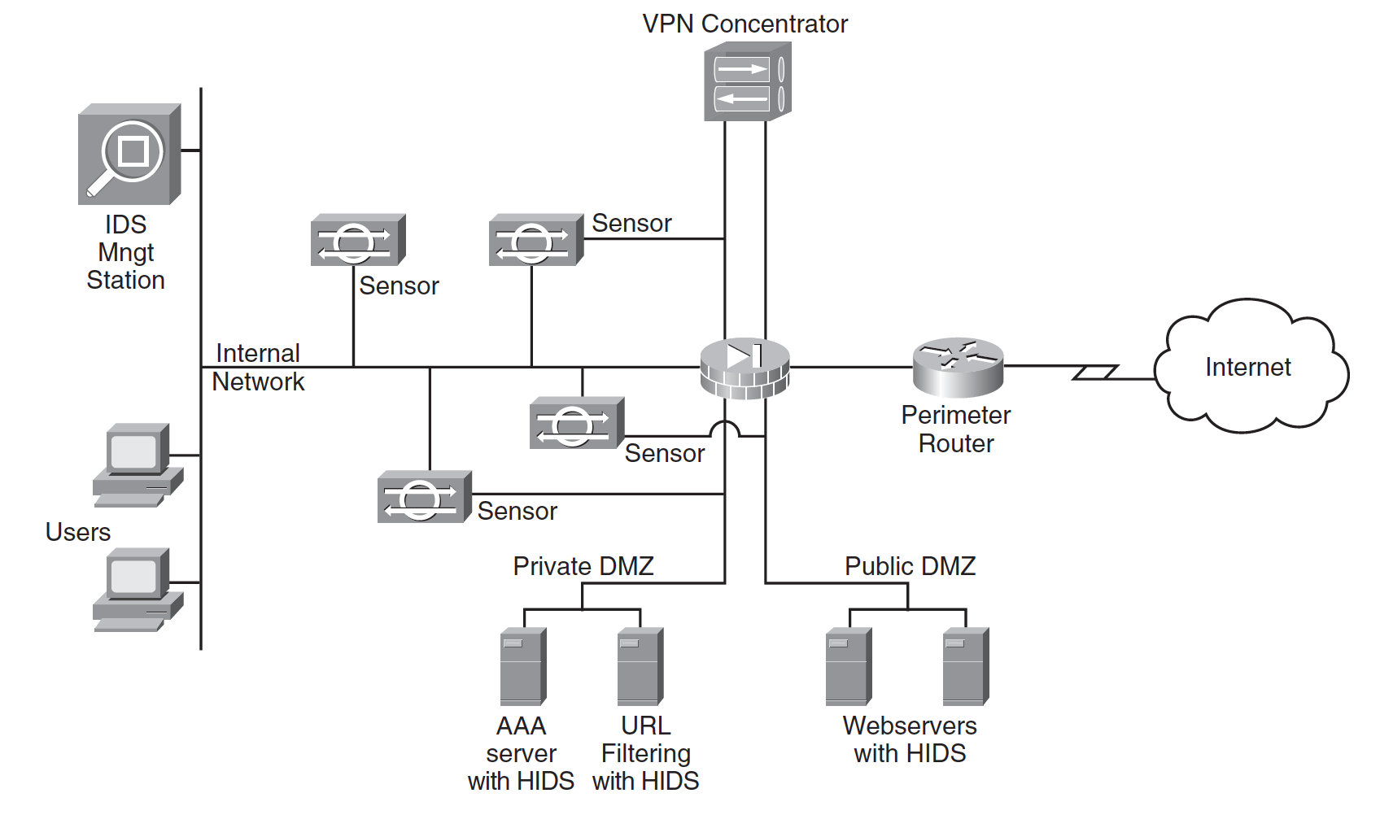

Slide 15
Course Contents

Slide 16
WIRELESS LAN DESIGN
Chapter 5

Slide 17
WLAN
The popularity of WLANs is undeniable.
The following 03 main driving forces play in favor of WLANs:
FLEXIBILITY
INCREASED PRODUCTIVITY
COST SAVINGS COMPARED TO WIRED DEPLOYMENT

Slide 18
FLEXIBILITY
WLANs let users access servers, printers, and other network resources regardless of their location, within the wireless reach.
This flexibility means that, for example, a user's laptop stays connected working from a colleague's cubicle, from a small meeting room, or from the cafeteria.
Recognizing the benefits brought about by WLAN flexibility, businesses are now deploying WLANs in record numbers.

Slide 19
INCREASED PRODUCTIVITY
According to a 2003 NOP World research study, WLAN users stayed connected to their corporate network 3.64 hours per day longer than their wired peers, thus increasing their productivity by 27 percent.
Through the flexibility of WLANs, not only does the productivity go up, but the response times are also significantly improved

Slide 20
COST SAVINGS
Another --- WLANs is their low-cost deployment in locations where the costs of running LAN wire would be prohibitive.
The total cost of ownership (TCO) of a WLAN is very low compared to the benefits they bring to an organization, providing that a WLAN is secured and managed properly.
Companies that are not deploying WLANs quickly enough find that employees take the matter in their own hands and install their own WLANs, potentially creating significant breaches in the corporate network security infrastructure

Slide 21
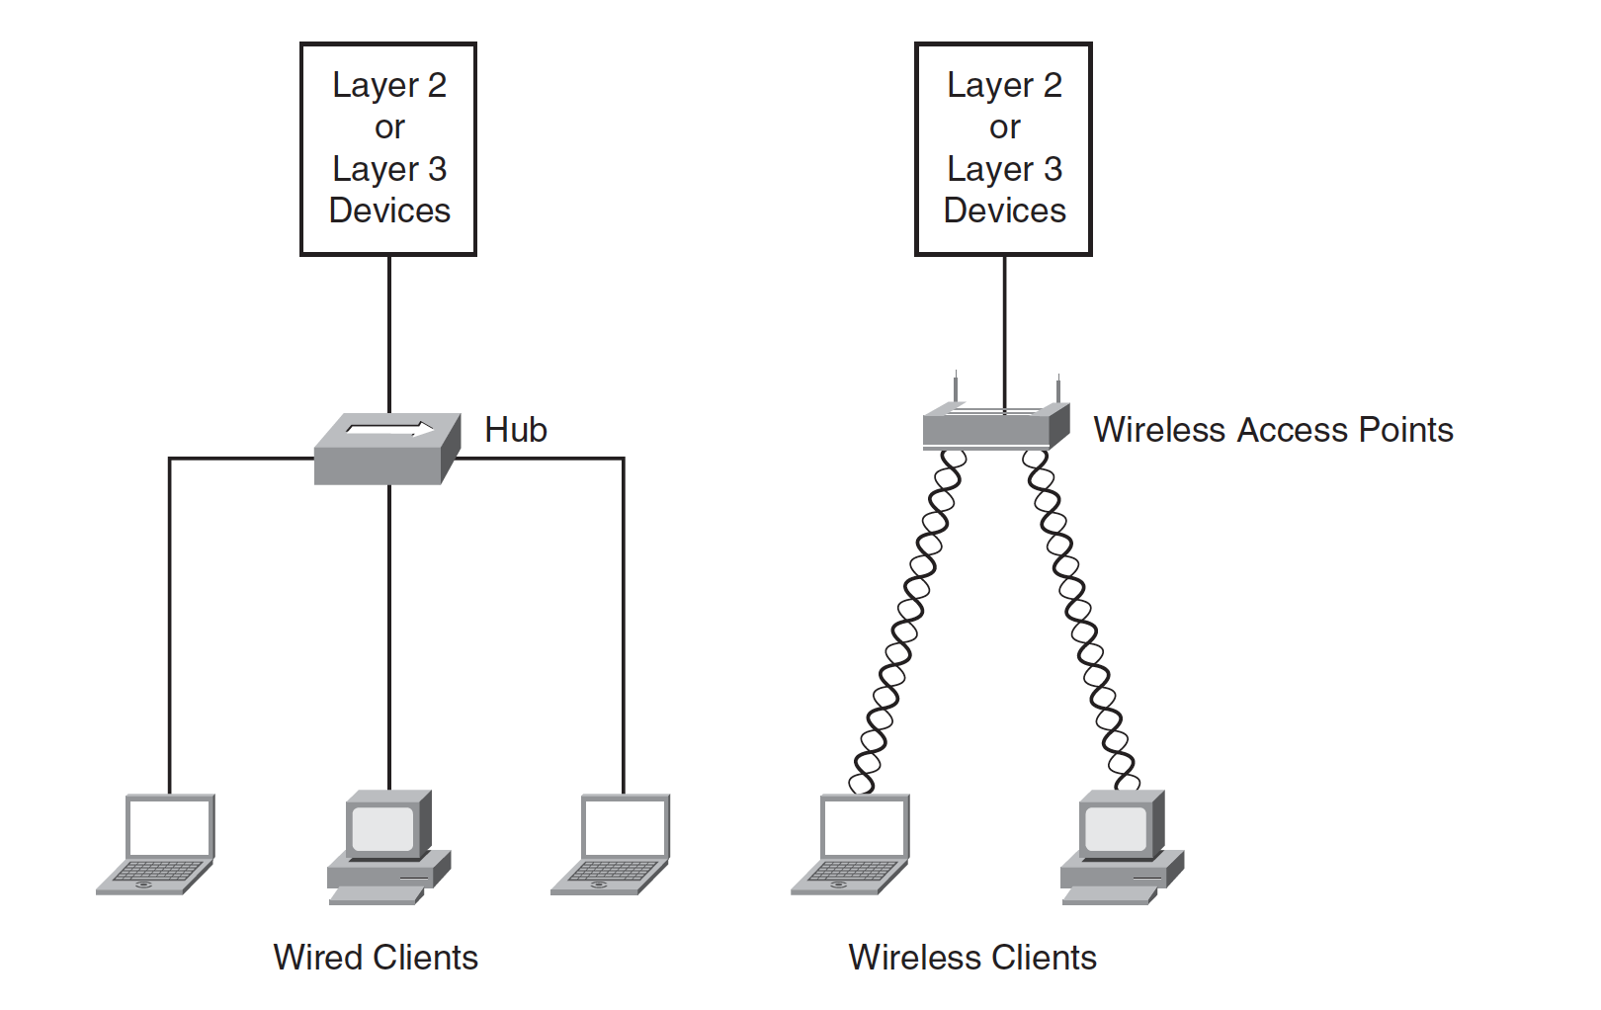
WIRELESS TECHNOLOGY OVERVIEW
a WLAN is an LAN that uses radio frequency (RF) to communicate instead of using a wire
Wireless clients connect to wireless access points (WAPs).

Slide 22
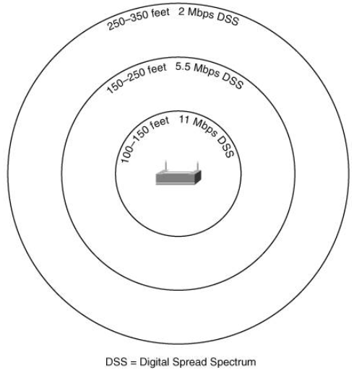
WIRELESS TECHNOLOGY OVERVIEW
Because WLANs use RF, the throughput (speed) is inversely proportional to the distance between the transmitter and the receiver.
Therefore, everything being equal (notwithstanding interferences), the closer a wireless client is to a transmitter, the greater is the throughput
Wireless communication brings a trade-off between:
flexibility and mobility versus battery life and usable bandwidth.

Slide 23
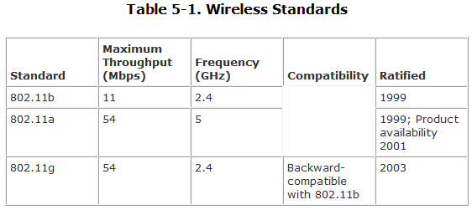
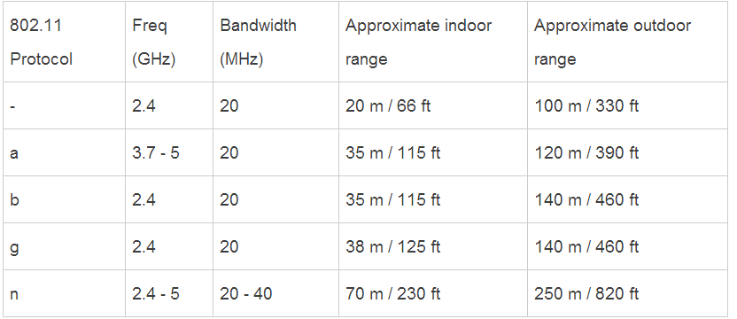
Wireless Standards
2Mbps
54 Mbps
11Mbps
54 Mbps
100 Mbps

Slide 24
